Slide 1
Corporate Social Responsibility (CSR) – Society and People Pillars
Presenter:
Karla Guzman-Mims
Corporate Social Responsibility Manager,
The Mosaic Company
The Sustany Foundation – Sustainability@Work
June 12, 2020

Slide 2
Who We Are
Fortune 500 company incorporated March 2004. Combination of IMC Global Inc. & Cargill fertilizer businesses.
in operations and joint ventures (JVs) in: United States, Canada, Brazil, Paraguay, China, India, Australia, Peru (JV), Saudi Arabia (JV)
Notes:
Say a few words about Mosaic and my role/experience in CSR.

Slide 3
POLL
QUESTION

Slide 4
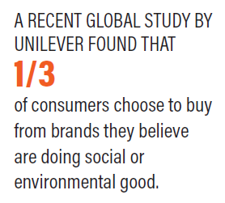
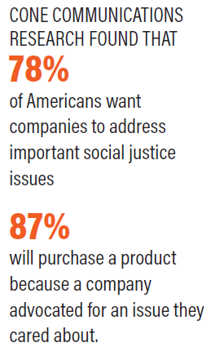
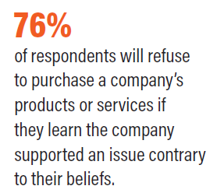
Findings
https://www.diversitybestpractices.com/corporate-social-responsibilty-di-critical-partnership-dbp.pdf
Notes:
As heighten external expectations of companies increase, it is important to know that what a business do and how we do it matters… and people are paying attending.

Slide 5
Corporate Social Responsibility (CSR)
CSR is achieved when a business adapts all its practices to ensure that it operates in ways that meets or exceeds the ethical, legal, commercial and public expectations that society has of business (The CSR Index, 2007).
According to Boston College Center for Corporate Citizenship, CSR goes beyond addressing surface-level sustainability efforts or corporate philanthropy. Corporate citizenship is how a company exercises its rights, obligations, privileges, and overall corporate responsibility within their local and global environments.
Today’s leading responsible corporations draw on the collective impact of a variety of initiatives that address an array of trends and emerging issues. The underlying goal of corporate citizenship remains clear: create a better world in which to do business and a better world in which to live.

Slide 6
CSR and Performance Value
CSR
Multiple Stakeholder Orientation
Voluntary
Practices and Values
Brand Reputation
Cost Savings
Beyond Philanthropy & Sustainability
Notes:
CSR Drives performance within the business and helps people feel connected. The goal is to have buy in from all levels of the organization – everyone owns this work – it doesn’t live just with in one department.
Multiple Stakeholder Orientation
Employees – Biggest asset – “Take care of your employees and they’ll take care of your business” – Richard Branson – Virgin Group.
Community – Being a good neighbor
Government – Elected officials
Regulators – License to operate
Investors
Beyond Philanthropy & Sustainability
Move beyond transactional work and forms partnerships – transformational
Give the example of the Rodeo
Voluntary
These are the things we can control to hold ourselves accountable
Integrity – doing the right thing when no one is watching
Practices and Values
How a company leads – driven by mission and purpose
Sam will share with you some really interesting stats about how engaged employees positively impact a business.
Transparency
Brand Reputation
Social license to operate
Employee advocates – they are your biggest cheerleaders!
Cost Savings
Recruiting, hiring and retaining employees
Being proactive vs. reactive
Employees take the initiative to address and resolve issues – they feel vested
Risk Management

Slide 7
CSR – Society and People Pillars
Society
Community Development & Philanthropy
Product, Purpose and Societal Impact
Human Rights, Animal Rights & Supply Chain
People
Culture
Compensation and benefits
HR policies
Diversity and Inclusion
Training, Health and Safety
Notes:
Those who attended the last session learned about the environment pillar. The next session will touch on governance.
We’ll spend our remaining time discussing the society and people pillars of a sustainability plan at a high level.
The hope is for you to consider how your business, service and/or products affects all of your stakeholder groups and everything you do at ever step along the way.
Society
Supporting communities where you operate, have offices or where employees live
Allow or encourage employee volunteering, matching programs, employee-voted grants
Focused philanthropy – mission related so it is not diluted
Stewardship – understanding societal impacts of your business and addressing them/solutions and being transparent.
Again, what you do and how you do matters, consider your supply chain and everything you do along the way.
People
When is the right time to communicate about company culture?
Communicating your Sustainability plan from the beginning and often – starting with recruitment.
Not asking for salary history, equal pay
Parental leave for birthing and non-birthing parents, etc.
D&I – not just demographics but are employees included along the way and do they have a sense of belonging within the organization.
Training – setting them up to succeed, ensuring employees are supported and return home safe after every shift.
I hope this helps highlight how incredibly important these pillars are and how the employee stakeholder group can be engaged and supported to create even more value within your business.

Slide 8
Resources
Chief Executives for Corporate Purpose – CECP
Boston College Center for Corporate Citizenship – BC CCC
CSR and D&I: A Critical Partnership
www.mosaicco.com
Our Responsibility
2018 Sustainability Disclosure

Slide 9
Connect with us on social media and learn more at www.mosaicco.com.

